Slide 1
BANK MANAGEMENT SYSTEM​
Project Member :
Mr. Shasikanth​
Ms. Nalini Ganesan
Ms. Ragini M
Ms. Nivetha raj​
Mr. Sharath
Ms. Pranathi M ​
Guided By :
Prof. Indrakka Mali​​

Slide 2
Contents :
Introduction
ER Diagram
Working of Back-End
Annotations
APIs
Software Requirement
Features Of System
Conclusion

Slide 3
Introduction :
To Develop a Software for solving Financial applications of a Customer in banking Environment.
A Bank management System is an application for maintaining a persons account in bank.
The System Provides the Access to customer to Create Account edit,Delete,search accounts.
Deposits withdraw Cash from our accounts,also to view report of an account.

Slide 4
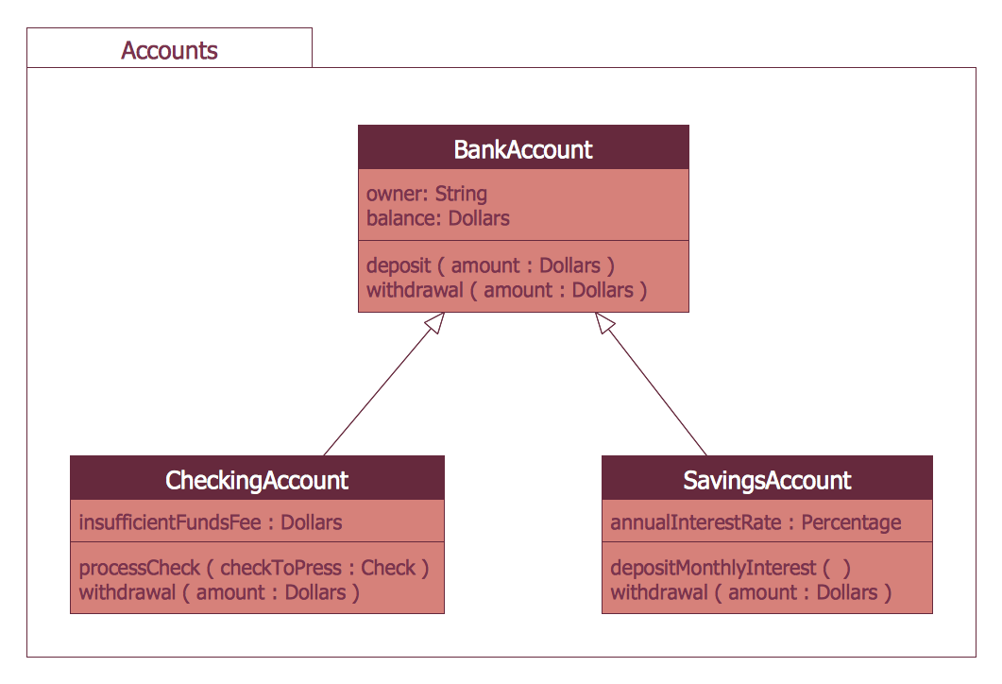
CLASS DIAGRAM

Slide 5
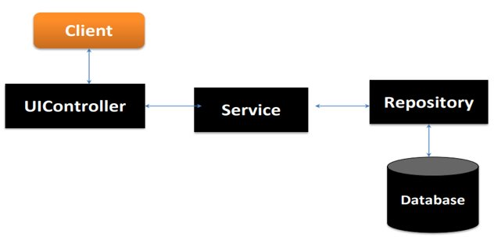
Working Of Back-End :
There are mainly three stages

Slide 6
Work Flow :
Client send a request to server for different options like inserting ,fetching ,update and delete a data.
When client hit on request .Request goes to the Controller Class and use respective URL to take data.
Then control of URL goes to the service Class And Conditions get Executed.
For returning response to client use same sequence. Service To Controller Class.
Here Repository class is used to interact with database using Hibernate Technology.

Slide 7
Annotations (@) :
Annotations are used to provide supplemental information
about a program.
Annotations start with ‘@’.
@Id : This id annotation is used to declare attribute as primary key.
@GeneratedValue : Used to generate value automatically when user insert new record in table.
3. @Not Empty : used for validation.

Slide 8
4. @Email : used to compare email format ​.​
5. @size : Used in collection. ​
6. @NotNull : This gives mandatory filed to enter data.​
8. @ManyToOne : To create the many-to-one relationship between the Student and subject class.​
9. @JoinColumn : helps us specify the column we'll use for joining.
10. @JsonIgnore : Is used to ignore the logical property used in serialization and deserialization.​
11. @Entity : is used is used to mark this class as an Entity bean.​
​

Slide 9
12. OneToMany : is used to create the one-to-many relationship between the subject id and Student entities​.
13. Cascadetype.All : ensure that all persistence events such as persist, refresh, merge and remove that occur on the parent, will be passed to the child.​
14. @override : Informs the compiler that the element is meant to override an element declared in a superclass.​
15. @RestController : This annotation is used at the class level and allows the class to handle the requests made by the client.​
16. @Autowired : Enables you to inject the object dependency implicitly.​

Slide 10
17. @ControllerAdvice : Allows to handle exceptions across the whole application in one global handling component.​
18. @ResponseStatus : To mark a method or an exception class with a status code and reason that should be returned.​
19. @ExceptionaHandler : Used to handle the specific exceptions and sending the custom responses to the client.​
20. @Service : It is used to mark the class as a service provider
21. @Notnull : It is used to makes entity as not null.
22. @Max : Max is used to validation to show the max value.

Slide 11
23. @Repository : Repository is used in repository class.
24. @Query : Its declares finder queries directly on repository methods.

Slide 12
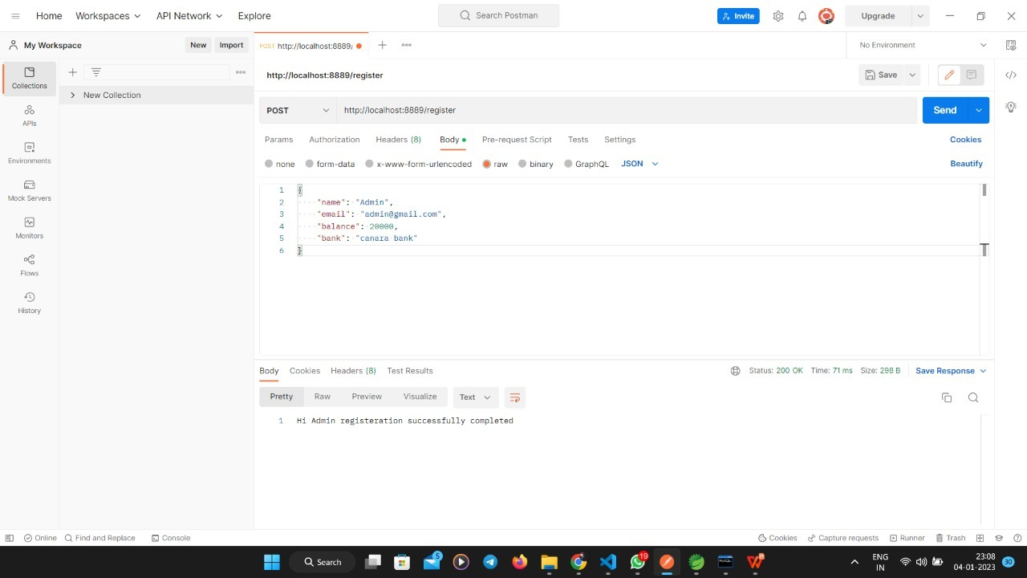
Application Programming Interface(APIs);
APIS Under Director To Do :
“director/all/” : Direct can access all student details using this URL.

Slide 13
Customer URL:
1. “post/register” : To add the customer details in table.
2. “get/getallusers” : we can get all customer record which is in customer table.
3. “delete/cancel/id” :​ It is used to delete particular record in table to use customerid.
4. “put/update/id” : It is to update particular customer by customerid.
5. “get/findbyid/id” : This url is to get a particular customer by using customerid.
6. “get/findbyemail/email” : Its used to get particular customer by its name.

Slide 14
Software & hardware used :
Software Requirements :
Operating System : Windows 7, 8, 10, 11
Language : Java
IDE : Spring Tool Suite
Client : Postman
Backend : MySQL
Frontend:Angular
Hardware Requirements :
CPU : Intel Pentium V processor
RAM : 4 GB or above
Hard Disk : 64 GB hard disk space or minimum

Slide 15
Advantages :
Banks software is simple and easy to use.
Software saves time.
Efficient customer service.
Banks can ensure effective compliances with regulators.
Easier Review of Documents during Audit.
Easier to assign Roles and Responsibilities.

Slide 16
Conclusion :
The project entitled as Bank Management System is the system that deals with the issues related to a bank software.
This project is successfully implemented with all the basic features mentioned in system requirements specification.
Awareness and right information about any bank is essential for both the bank of faculty as well as customers.
So this serves the right purpose in achieving the desired requirements of both the communities.

Slide 17


